Slide 1
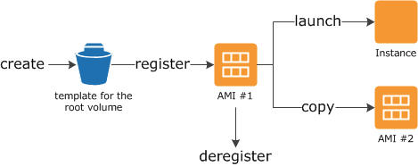
Amazon Machine Images (AMI)
You can also launch instances from as many different AMIs as you need.
An AMI includes the following:
A template for the root volume for the instance (for example, an operating system, an application server, and applications)
Launch permissions that control which AWS accounts can use the AMI to launch instances
A block device mapping that specifies the volumes to attach to the instance when it's launched

Slide 2
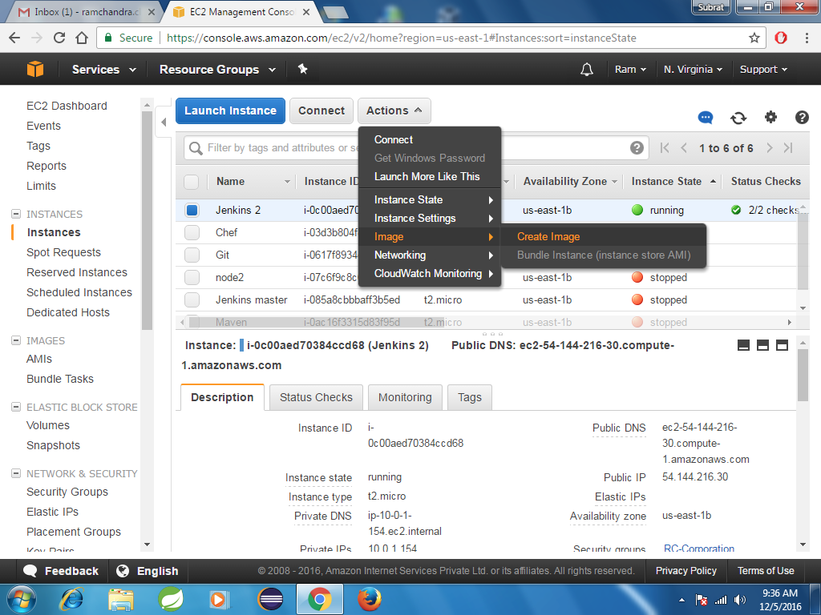
Click on Create Image and give the names whatever you want to give and

Slide 3
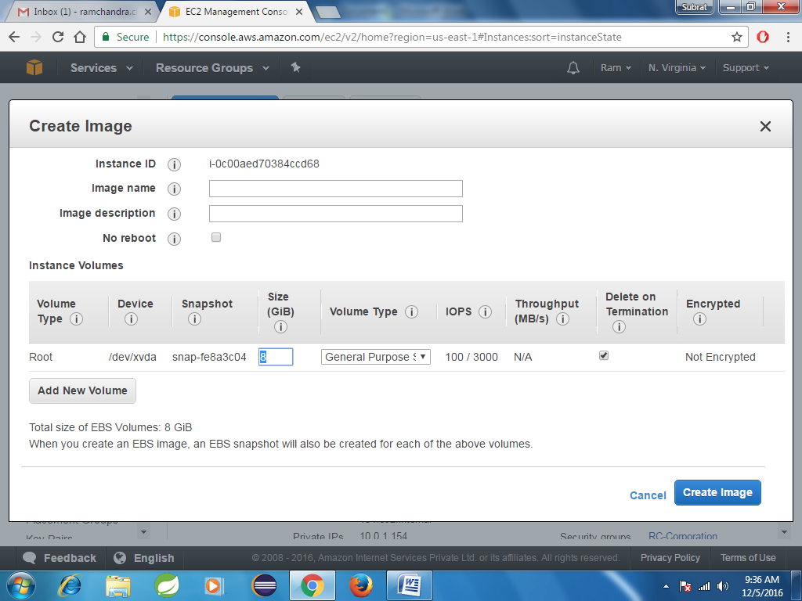
You can choose volume type based on your business need here we are going with GP2(general purpose)
Go through the below link for more about Volume types:
http://docs.aws.amazon.com/AWSEC2/latest/UserGuide/EBSVolumeTypes.html

Slide 4
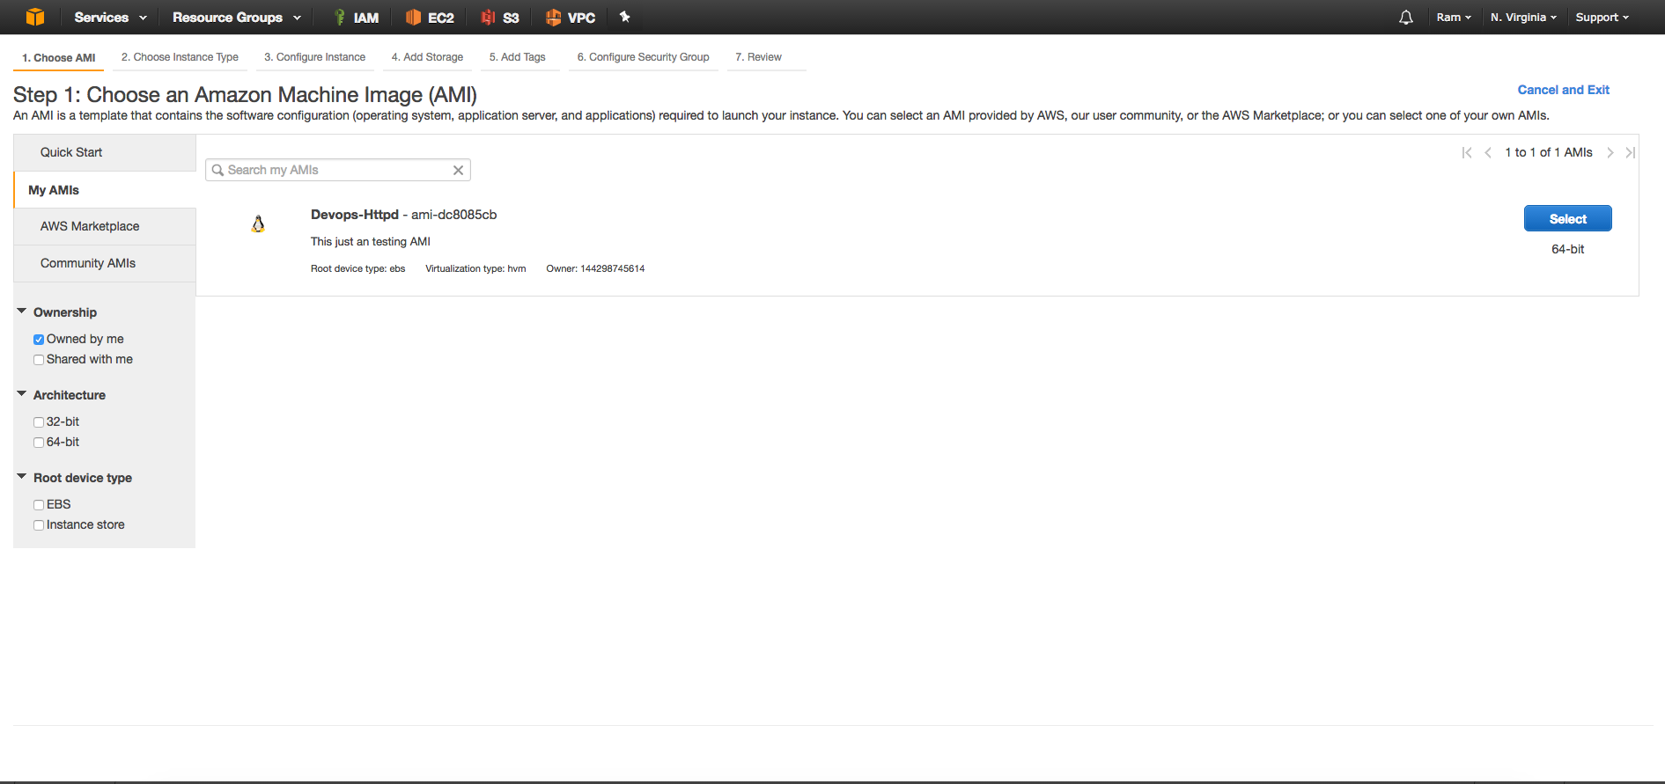
Wait for 5mins of time once the AMI has been created go to Instance launch Wizard --select my AMI’s
Now you can see whatever the AMI you have created here in this tutorial i have created ‘Devops-httpd’
With this AMI you can launch your Instance

Slide 5
You can make that AMI available to all regions by using copy command
For FAQ’s please go through the below link:
https://aws.amazon.com/amazon-linux-ami/faqs/

